Slide 1
Team hector
Project on the topic “Aqua”

Slide 2
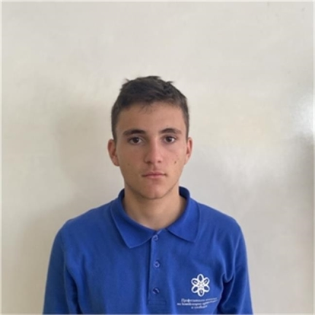
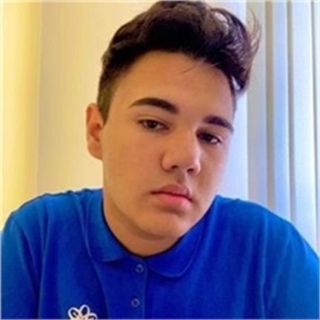
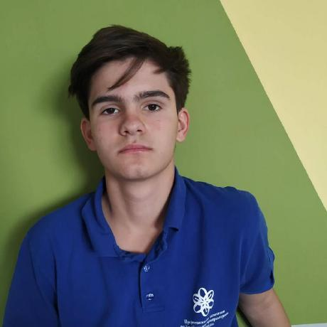


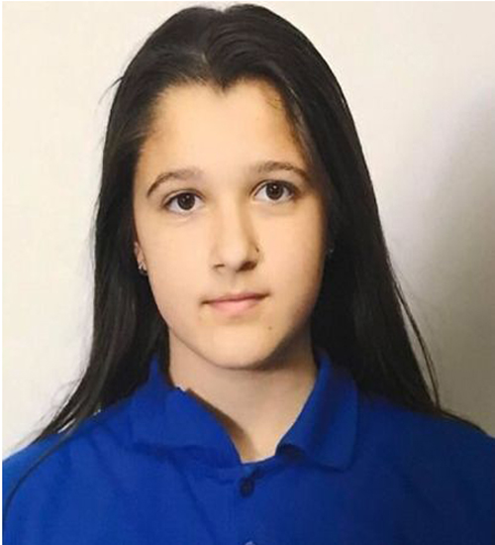
Our team

Slide 3
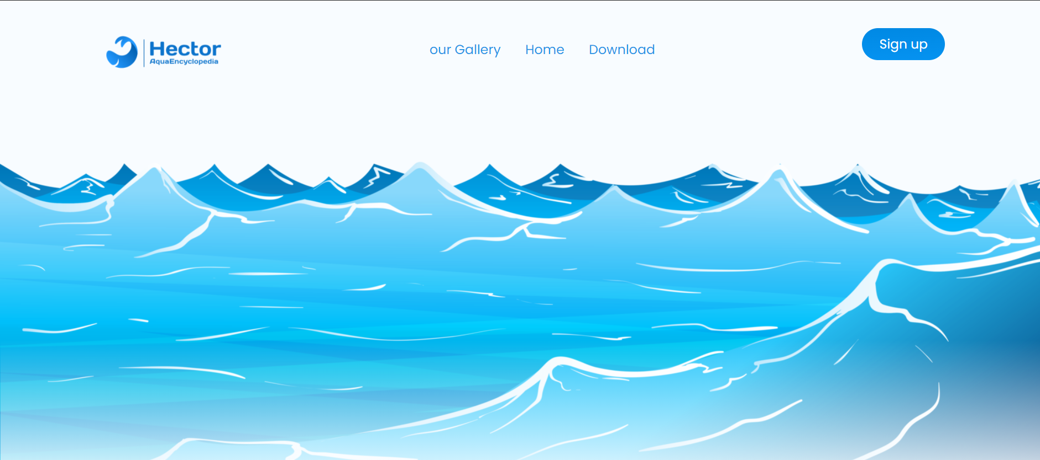
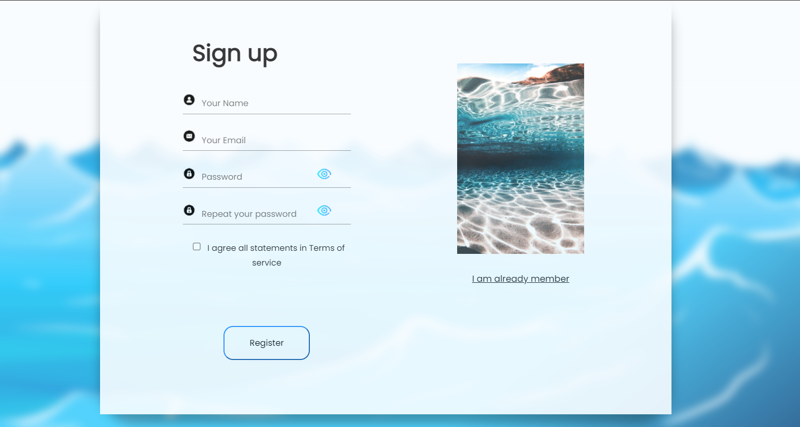
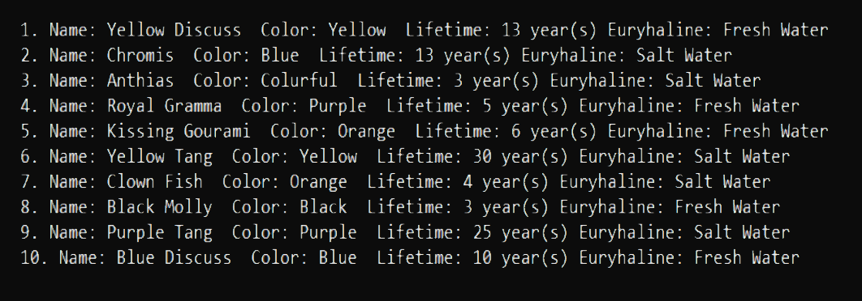
Our idea

Slide 4



Stages of development
1.
3.
2.

Slide 5











The programs we used

Slide 6

Future ideas and purposes

Slide 7
Let’s jump to the website!

